Slide 1
Nut & Bolt Finishes

Slide 2
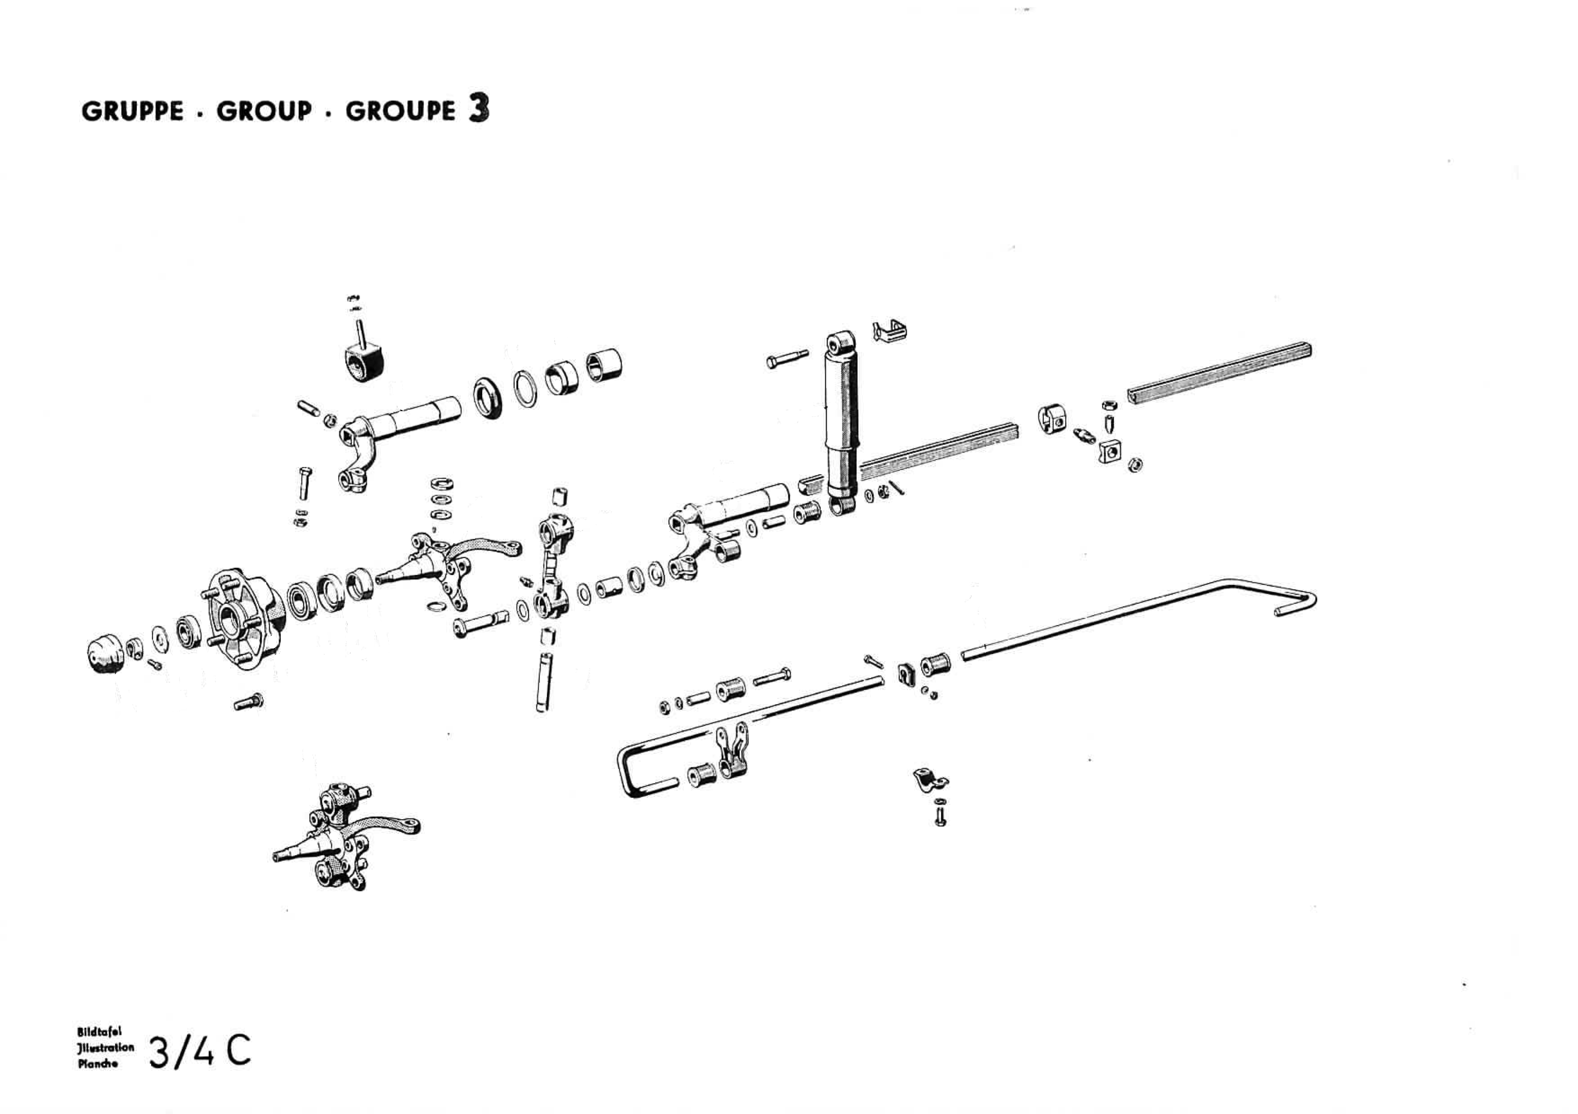
12B
52B
11B
36B
37B
38B
55B
54B
63B
59B
65B
64B
61B
60B
68B
67B

Slide 3
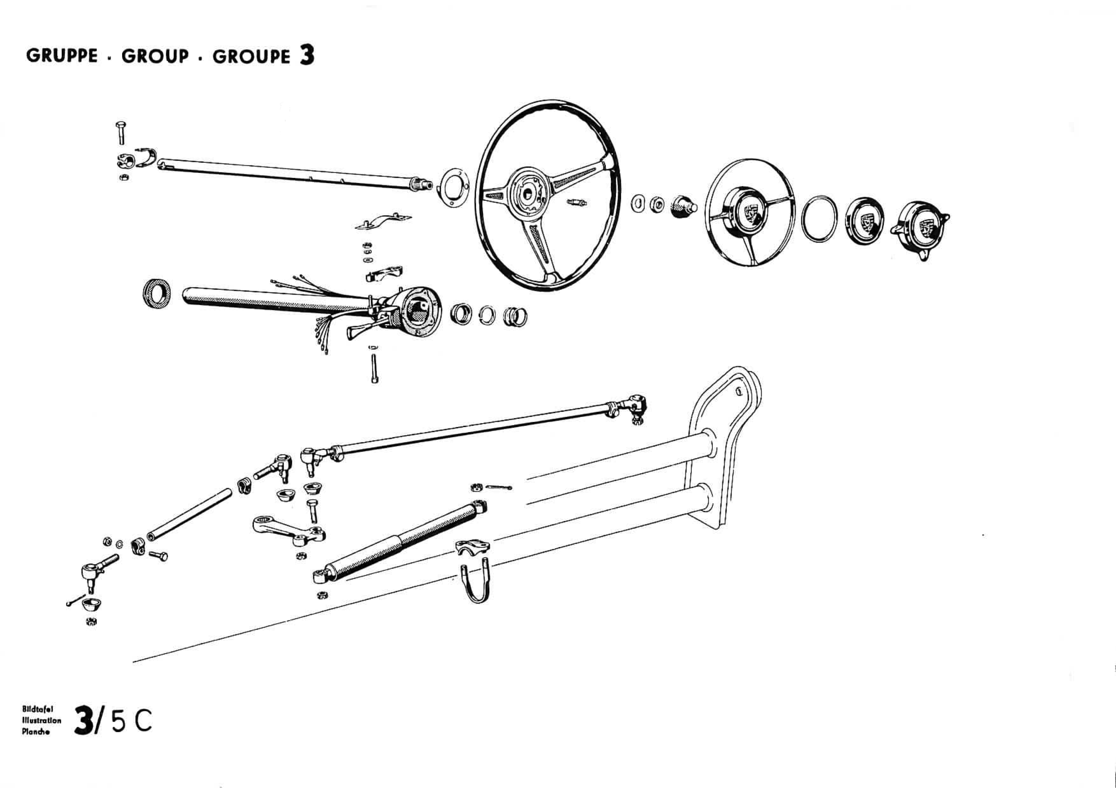
25B
47B
46B
26B
37B
35B
33B
36B
32B
6B
16B
15B
14B
6B
6B

Slide 4
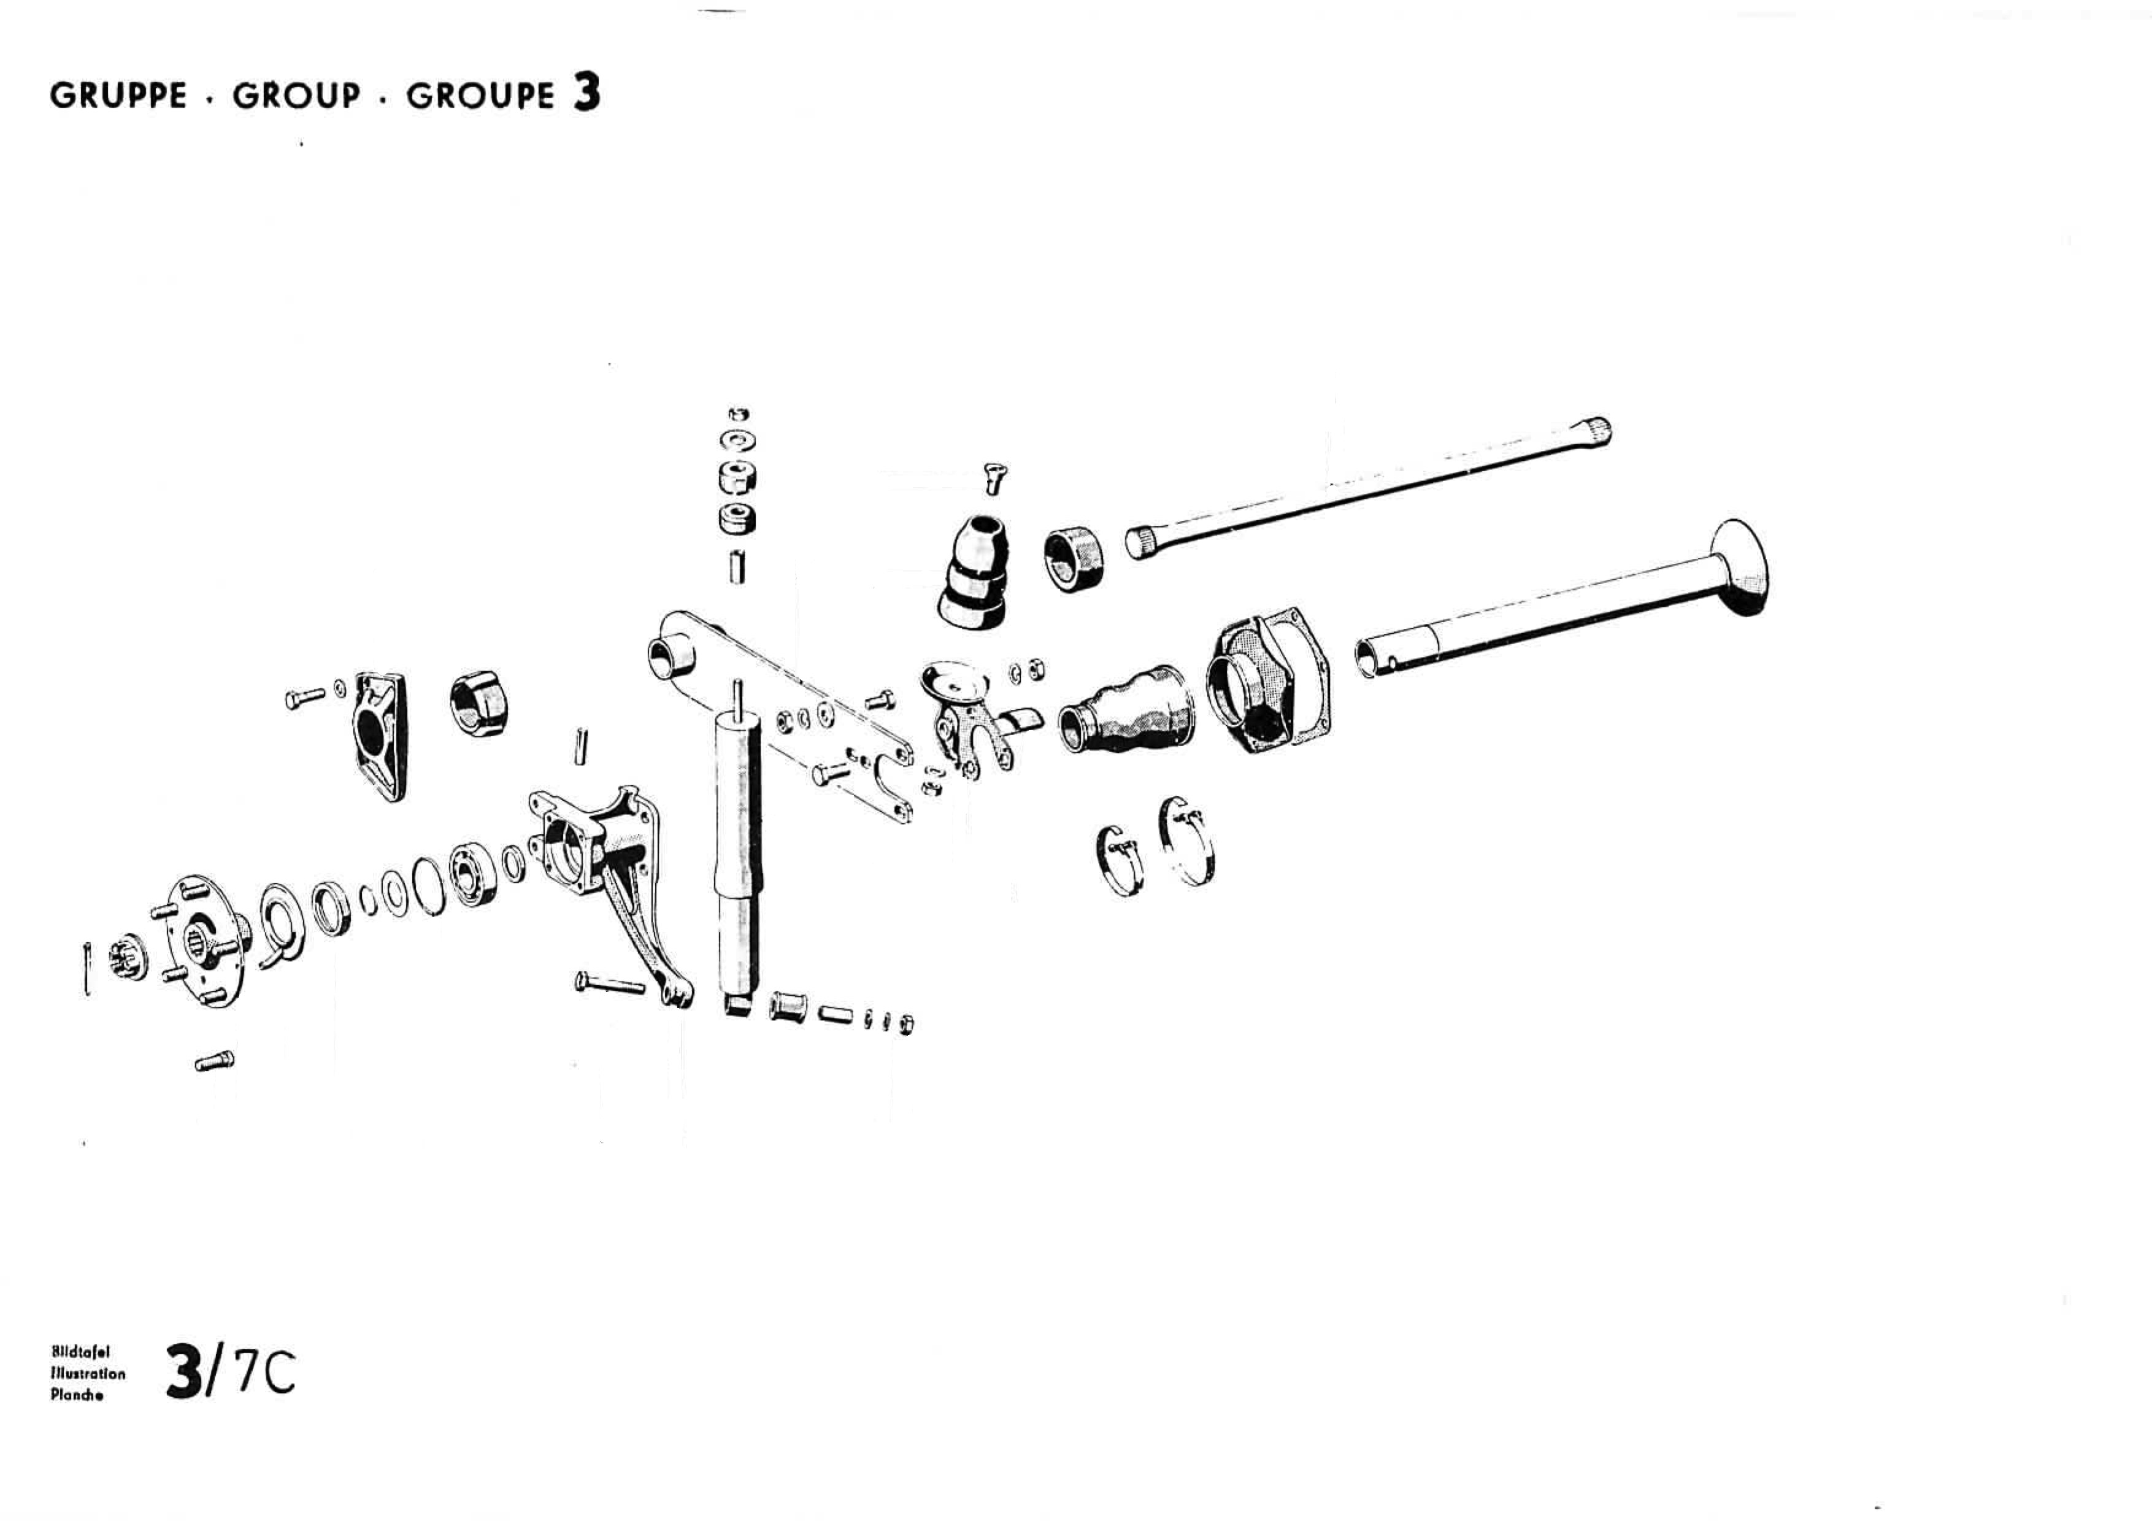
44B
43B
12
33B
34B
24B
23B
22B
21B
23B
24B
29B
24B
28B
14
37B
15
16

Slide 5
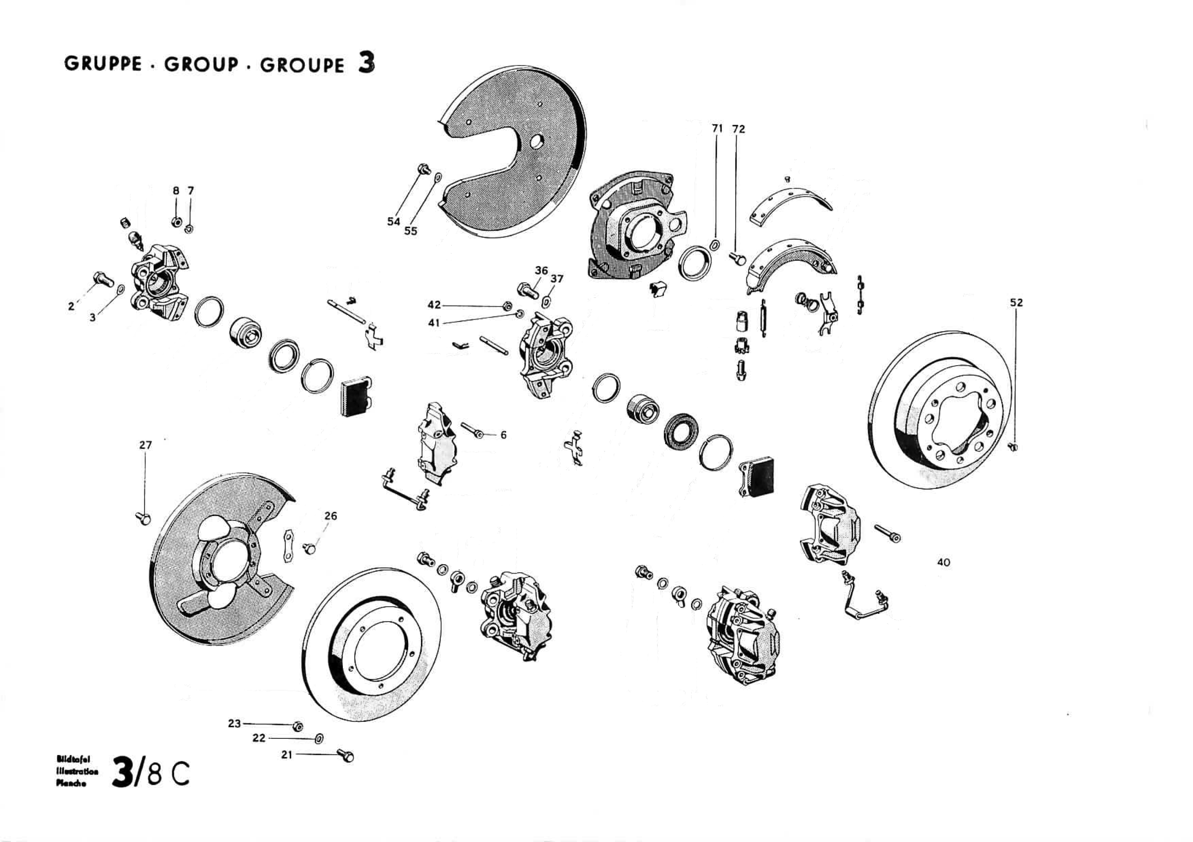

Slide 6
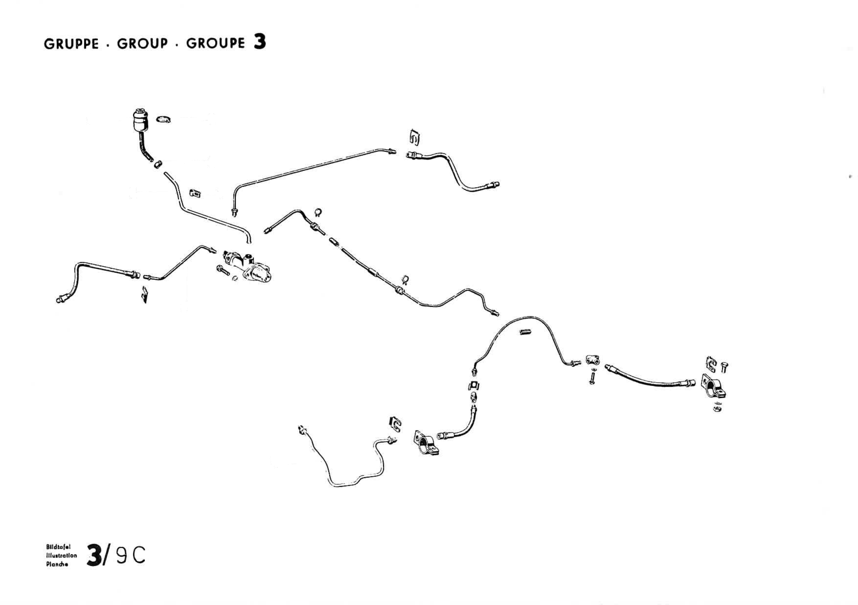
26B
26B
26B
2B
3B
26B
28B
29B
30B
27B
27B

Slide 7
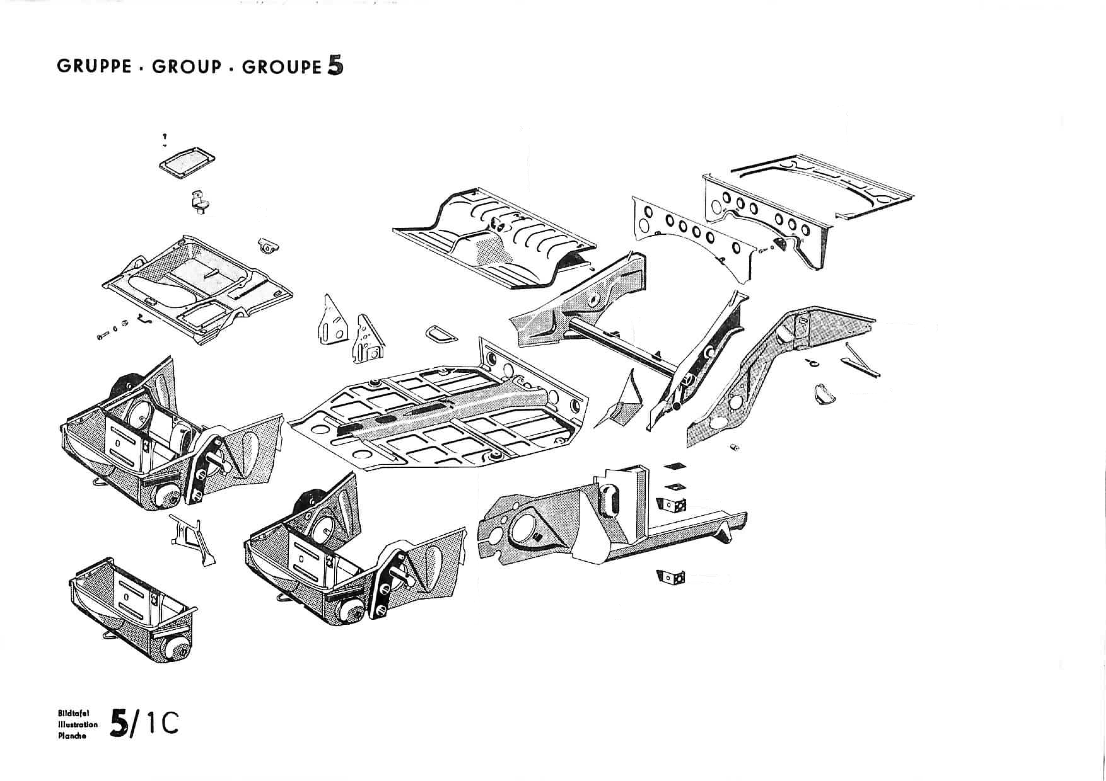
11B
12B

Slide 8
VW substitute parts

Slide 9
1
2

Slide 10
2
1
10B

